Slide 1
An Introduction to ACMG Guidelines and Variant Curation – Part 1
Grace Tan
National University of Singapore
13th Oct 2023

Slide 2

The purpose of Variant Curation
The scope of clinical genetic testing is diverse and constantly developing
Whole exome sequencing alone can detect over 300,000 variants in a single patient
Determining the significant from the noise can be difficult

Slide 3
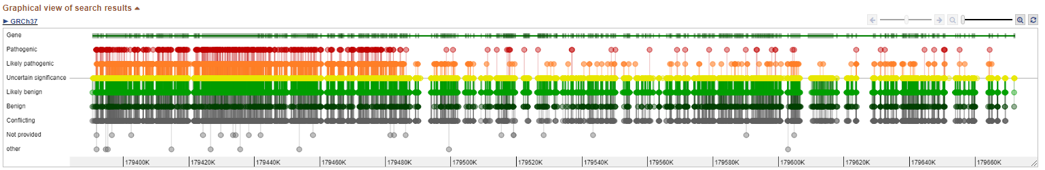
What is Variant Curation?
Variant curation is the application of evidence-based methods for the interpretation of genetic variants
By collating, examining and interpreting the data surrounding a genetic variant, sequencing data can be turned into actionable results
However, there is significant variability in this process between individual laboratories/clinical groups
Fig 1 - Variant distribution in TTN
https://www.ncbi.nlm.nih.gov/clinvar/?term=TTN%5Bgene%5D&redir=gene

Slide 4
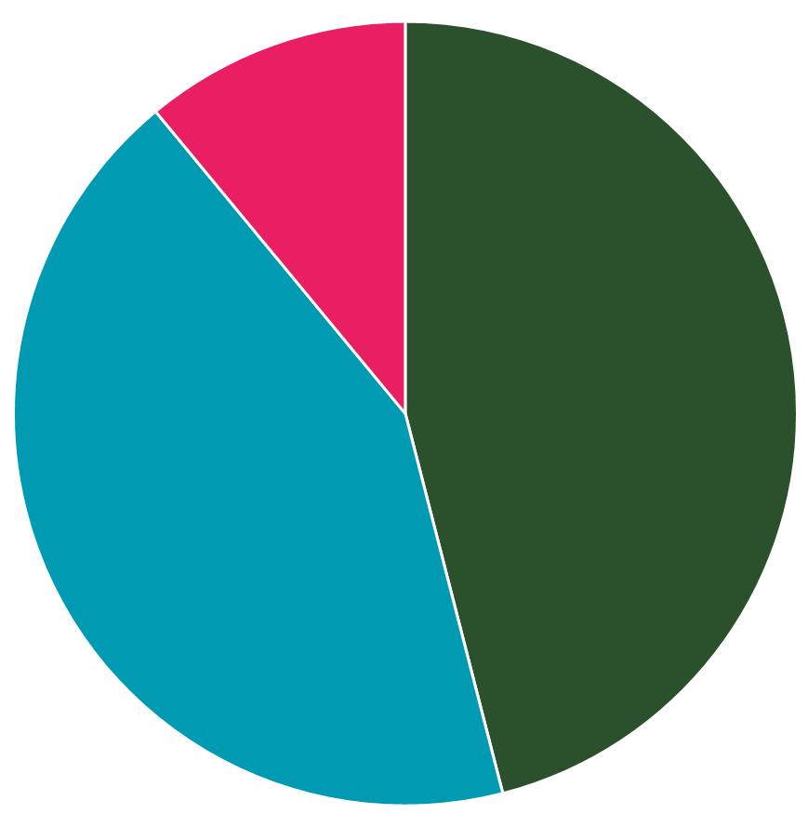
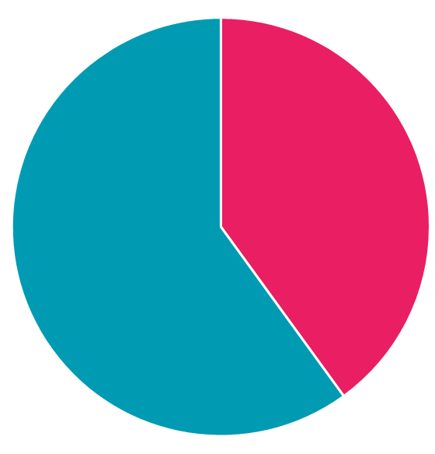
Problem: Variability in Interpretations
Variants with a benign/likely benign vs uncertain conflict 43%
Variants with at least 2 submissions on the same condition and no conflicts
60%
Other conflicts 46%
Variants with any conflict 40%
Variants with a clinically significant conflict
(e.g. benign vs pathogenic) 11%
Breakdown of Variants with Conflicting Interpretations in Clinvar
Data taken from ClinVar Miner: https://clinvarminer.genetics.utah.edu/variants-in-conflict-by-significance
Henrie, Alex et al. “ClinVar Miner: Demonstrating utility of a Web-based tool for viewing and filtering ClinVar data.” Human mutation vol. 39,8 (2018): 1051-1060. doi:10.1002/humu.23555

Slide 5
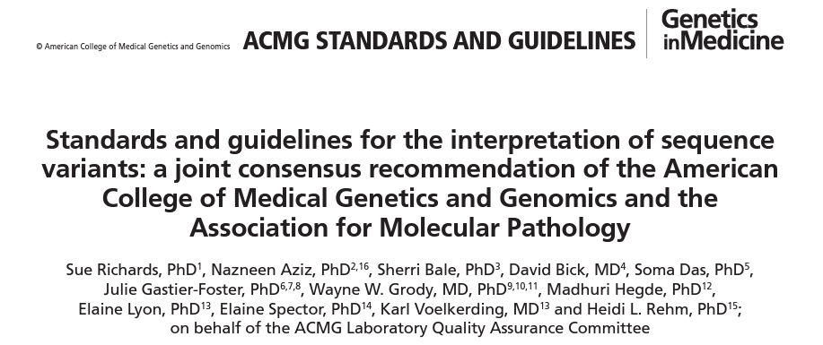
Solution: Standardised Criteria
ACMG Guidelines: Established by clinicians and clinical lab directors who are part of the American College of Medical Genetics and Genomics (ACMG), Association for Molecular Pathology (AMP), and College of American Pathologists (CAP)
By using standardised terminology, methods and evidence-based criteria, this ensures that variant curation decisions are accurate, traceable, and consistent

Slide 6
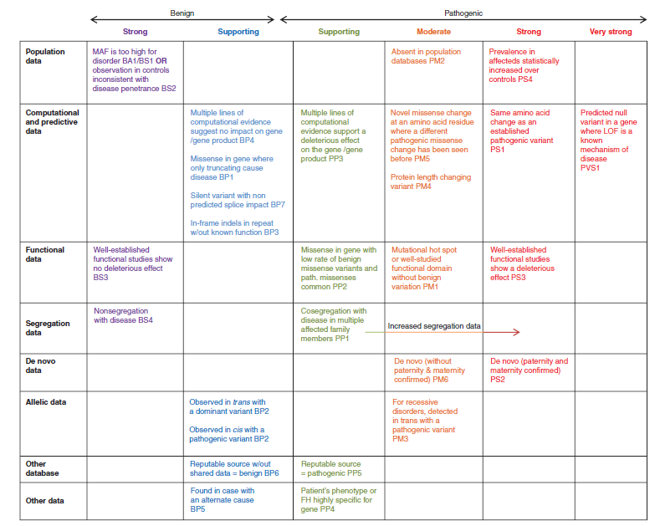
ACMG Guidelines
The guidelines utilise typical types of variant evidence:
Population, Computational, Functional, Segregation, De novo, Allelic, Other database, and Other.
28 criteria, divided into Pathogenic or Benign
Further divided by weight
Curation is carried out through collation and evaluation of evidence that meets these criteria

Slide 7
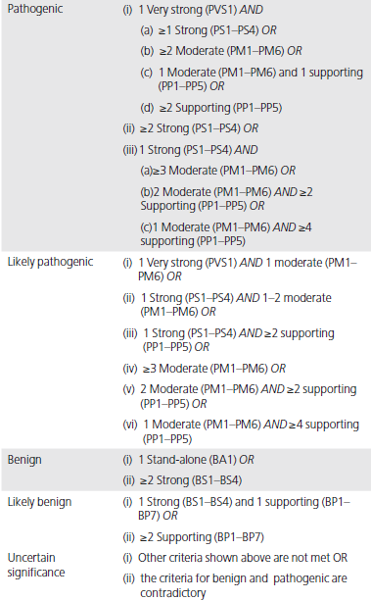
ACMG Guidelines
The criteria then are combined to choose a classification from the five-tier system:
Pathogenic
The variant is considered the cause of the patient’s disease
Likely Pathogenic
The identified variant is considered the probable cause of the patient’s disease
Still some uncertainty, use caution in clinical decision-making
Uncertain Significance
The variant could be the cause of the patient’s disease, but insufficient or conflicting evidence exists
Likely Benign
The variant is not likely to be the cause of the patient’s disease
Benign
The variant is not considered to be the cause of the patient’s disease

Slide 8
Variant Nomenclature

Slide 9
Variant Nomenclature
A standard gene variant nomenclature is maintained and versioned by the Human Genome Variation Society (HGVS), and its use is recommended as the primary guideline for determining variant nomenclature (http://www.hgvs.org/mutnomen)
Clinical reports should include sequence reference and coding and protein nomenclature to assist in functional interpretations
e.g., “g.” for genomic sequence, “c.” for coding DNA sequence, “p.” for protein, “m.” for mitochondria
A reference transcript for each gene should be used and provided in the report when describing coding variants. The transcript should represent either the longest known transcript and/or the most clinically relevant transcript

Slide 10
ACMG Criteria

Slide 11
Computational & Predictive data
PP3/BP4: Multiple lines of computational evidence support a deleterious effect/suggest no impact on the gene product
Majority of predictions must agree
Many in-silico algorithms may use the same or very similar input for their predictions, hence predictions cannot be counted independently. i.e. if there are 4/5 pathogenic predictions, PP3 is still counted only once in the curation
Not applied if PVS1 is applied to avoid double counting evidence

Slide 12
Computational & Predictive data
BP1: Missense variant in gene where primarily truncating variants cause disease
BP7: Silent variant with non-predicted splice impact
PS1: Same amino acid change as a previously established pathogenic variant, regardless of nucleotide change.
E.g. Variant being curated: c.333C>A:p.Arg111Pro
Other variant reported as pathogenic: c.333C>G:p.Arg111Pro
PM5: Different missense change at an amino acid where a previously established pathogenic missense change has been seen before
E.g. Variant being curated: Arg123Pro.
Other variant reported as pathogenic: Arg123Val

Slide 13
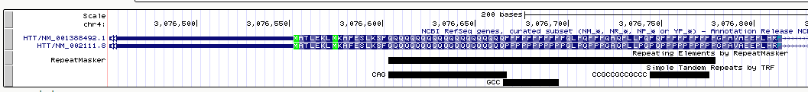
Computational & Predictive data
PM4: Protein length changing variant
Applicable for in-frame deletions, insertions, or stop-loss variants, but NOT frameshifts, nonsense, and splice variants
Cannot be applied if PVS1 is applied
Not applied to repeat regions
BP3: In-frame deletions/insertions in a repetitive region without a known function
UCSC Genome Browser
Tracks

Slide 14
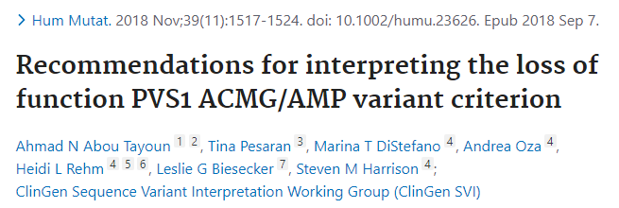
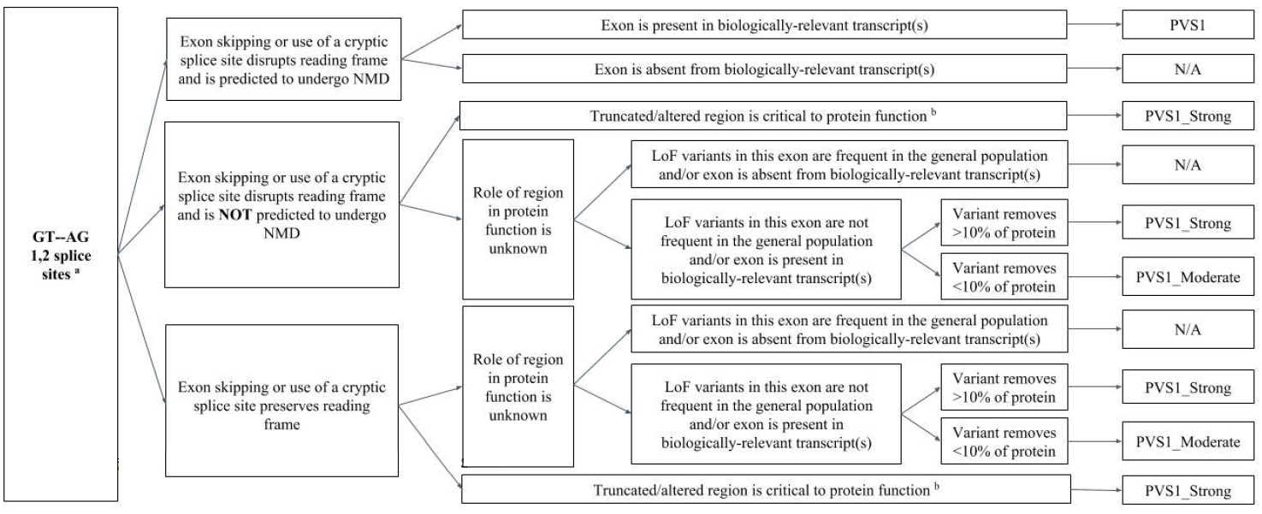
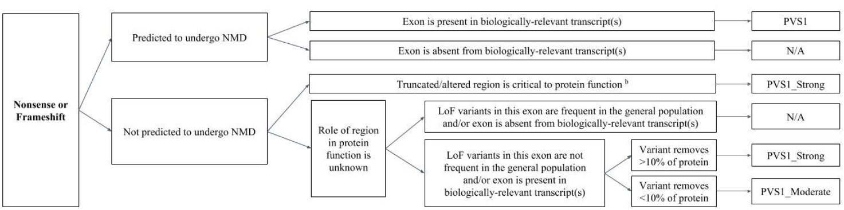
Computational & Predictive data
PVS1: Predicted null variant (nonsense, frameshift, canonical ±1 or 2 splice sites) in a gene where Loss Of Function is a known mechanism of disease.
Beware of genes where LOF is not a known disease mechanism (e.g. MYH7)
Use caution interpreting LOF variants at the extreme 3′ end of a gene
Use caution in the presence of multiple transcripts (search for biological relevant transcript)
Given the weighting and impact of this criterion, accounting for these considerations can be critical

Slide 15
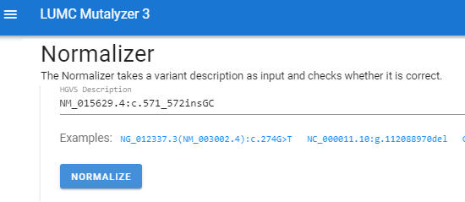
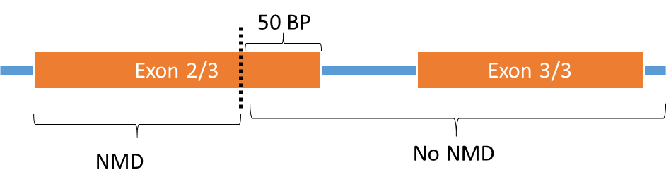
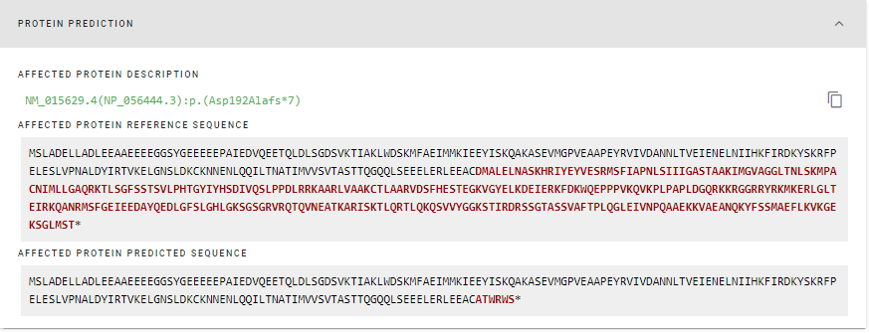
Computational & Predictive data
Nonsense: Base change of variant creates a premature stop codon
Frameshift: Changes reading frame, may create a premature stop codon
Splicing: loss or gain of splice sites may lead to changes in the transcribed sequence or cause a frameshift or premature stop codon
Premature stops occurring before the last 50 bases of the second last exon lead to Nonsense Mediated Decay
Premature Stop codon positions
Second Last Exon
Last Exon

Slide 16
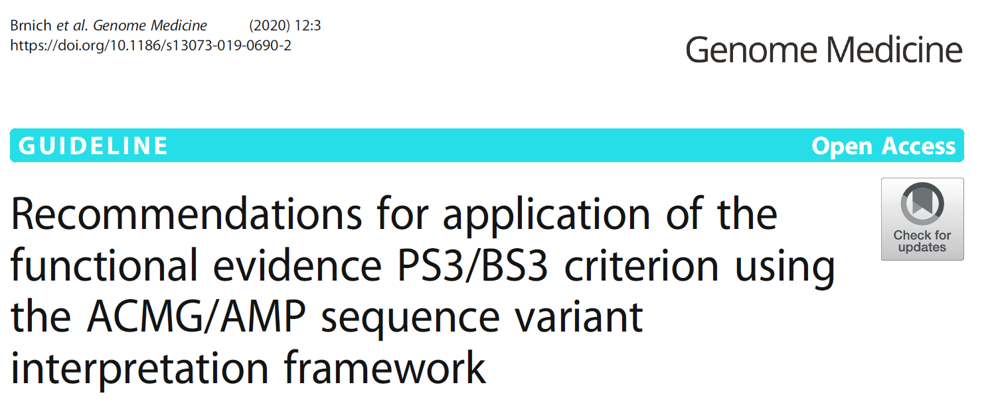
Functional Data
PS3/BS3: Well established functional studies show a deleterious effect/ show no deleterious effect
Assays should be well validated or linked to the phenotype, and relevant to disease mechanism and manifestation
Variant-level evidence needed to satisfy PS3 or BS3 criteria
e.g. An in-vitro assay of enzyme activity implicates the gene encoding the non-functional enzyme but does not isolate a specific variant’s effect, and therefore would not meet PS3 criteria but might be relevant for PP4

Slide 17
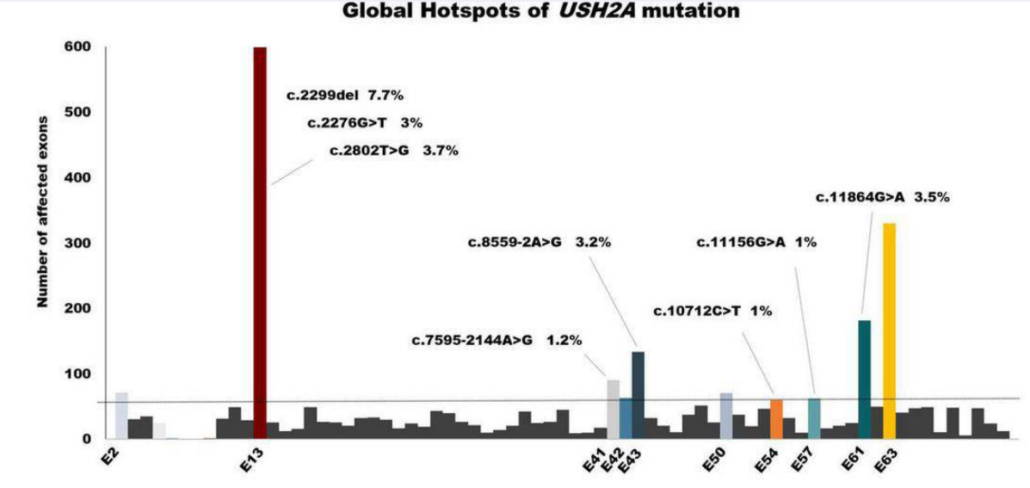
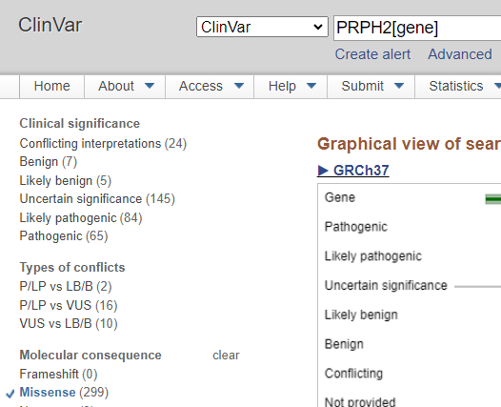
Functional Data
PM1: Missense variant in mutational hotspot or well studied functional domain without benign variation
Not meant for truncations
Su, Bing-Nan et al. “Global spectrum of USH2A mutation in inherited retinal dystrophies: Prompt message for development of base editing therapy.” Frontiers in aging neuroscience vol. 14 948279. 10 Aug. 2022, doi:10.3389/fnagi.2022.948279
PP2: Missense in gene with low rate of benign missense variants and pathogenic missenses common

Slide 18
Segregation data
PP1: Cosegregation with disease in multiple affected family members in a gene definitively known to cause the disease.
BS4: Lack of segregation in affected members of a family
Suggested ranking criteria for segregation:
Segregation data
Significant segregation: variant segregates with the same phenotype as the patient in 3 or more families or 1 large family to at least a third degree relative | PS
Moderate segregation: variant segregates with the same phenotype in 2 families | PM
Low segregation: variant segregates with the same phenotype as the patient in 1 family | PP

Slide 19

ACMG guideline part 2
Dr. Wei Ma
Genome Curation Scientist
Hong Kong Genome Institute
13th Oct 2023

Slide 20
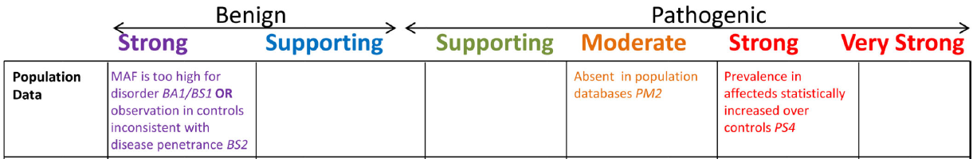
Normal population data (PM2, BA1, BS1, BS2)
PM2: Absent from controls (or at extremely low frequency if recessive)
BA1: Allele frequency is >5%
BS1: Allele frequency is greater than expected for disorder
BS2: Observed in a healthy adult individual for a recessive (homozygous), dominant (heterozygous), or X-linked (hemizygous) disorder, with full penetrance expected at an early age

Slide 21

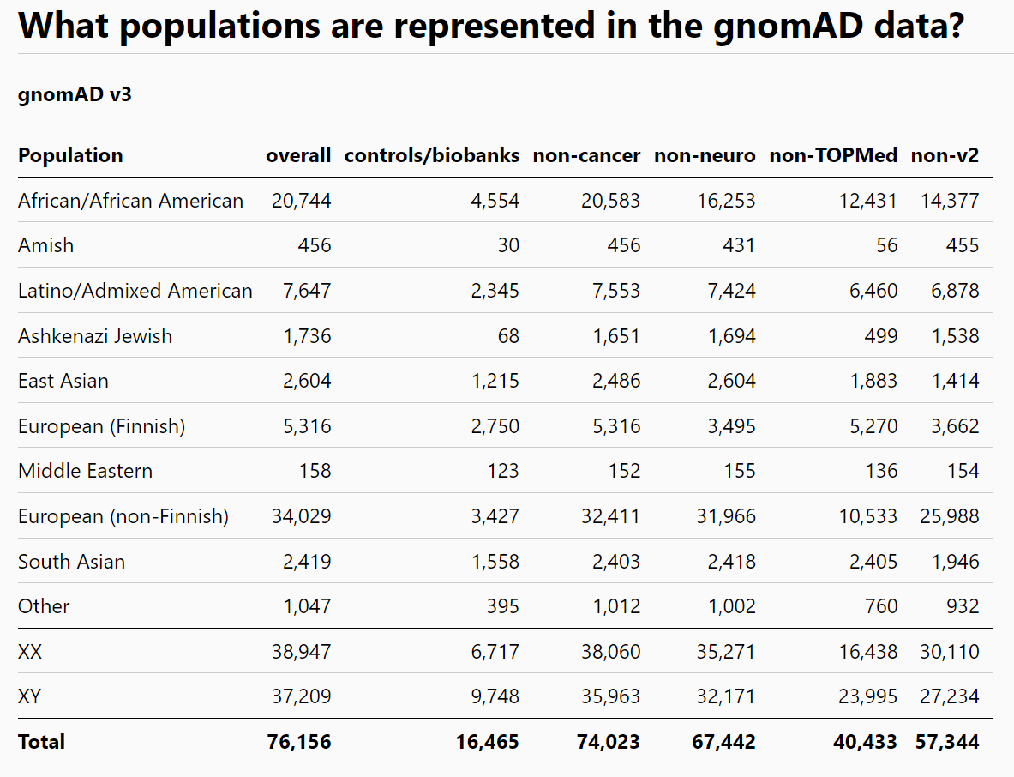
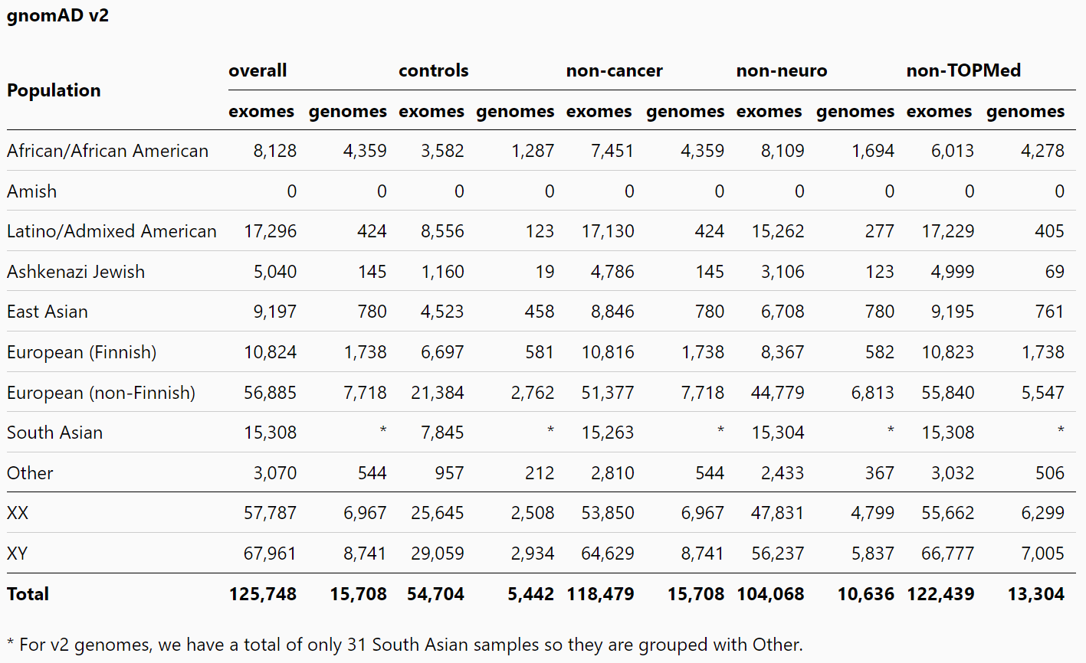
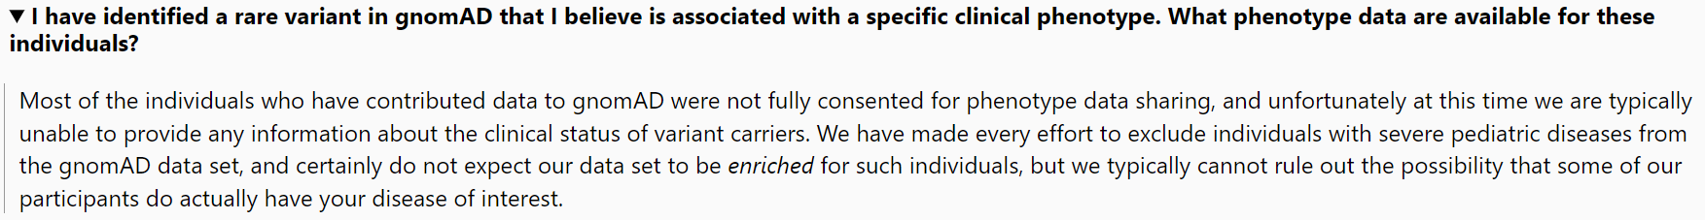
Genome Aggregation Database (gnomAD)
v2 release is composed of 125,748 exomes and 15,708 genomes (GRCh37)
gnomAD structural variant (SV) v2.1 represents 10,847 genomes (GRCh37)
v3.1 spans 76,156 genomes (GRCh38)
Contributed by worldwide genome projects
Full list available at https://gnomad.broadinstitute.org/about
useful reference sets of allele frequencies for severe pediatric diseases
can be used for adult-onset diseases (e.g. neurological diseases, caners) with additional filters

Slide 22




Asian-specific reference databases
The Chinese Millionome Database(CMDB)
141,431 WGS data from unrelated healthy Chinese individuals
TogoVar
15,989 WGS and 1,333 WES data from Japanese individuals
KOVA
1,896 WGS and 3,409 WES data from healthy Korean individuals
SG10K
10,000 whole-genome sequences from healthy Chinese, Indian, and Malay

Slide 23


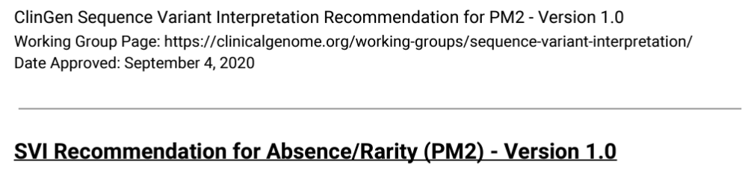
Update from ClinGen
BA1
Exception List (July 2018)
e.g. NM_004004.5(GJB2): c.109G>A (p.Val37Ile)
a common AR variant for hearing loss
reduced penetrance
https://pubmed.ncbi.nlm.nih.gov/30311383/
PM2
Downgrade to PM2_Supporting
Unless gene has ClinGen Expert Panel Specifications
https://clinicalgenome.org/docs/pm2-recommendation-for-absence-rarity/

Slide 24
Disease population data (PS4)
PS4: The prevalence of the RARE variant (must also meet PM2) in affected individuals is significantly increased compared with the prevalence in controls
Relative risk or odd ratios >5.0, and the confidence interval does not include 1.0.
For very rare variants, the prior observation of the variant in multiple unrelated patients with the same phenotype (only applicable to dominant diseases)
Can adjust from PS4 to PS4_Supporting
Exact threshold varies depending on the disease prevalence
E.g. ClinGen Hearing Loss vs RASopathy Expert Panel Specifications
Strong: ≥15 vs ≥5 probands
Moderate: ≥6 vs ≥3 probands
Supporting: ≥2 vs ≥1 probands

Slide 25







Useful databases
Disease variant databases
ClinVar
Human Gene Mutation Database
DECIPHER
Leiden Open Variation Database
Literature resources
PubMed
Google Scholar
Mastermind
Publication list at variant-level

Slide 26
De novo occurrence (PS2, PM6)
PS2: De novo (both maternity AND paternity confirmed) in a patient with the disease and no family history
PM6: Assumed de novo, but without confirmation of paternity OR maternity
Combined into one criteria in later ClinGen Recommendations

Slide 27
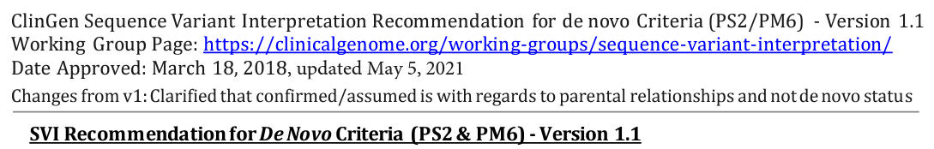
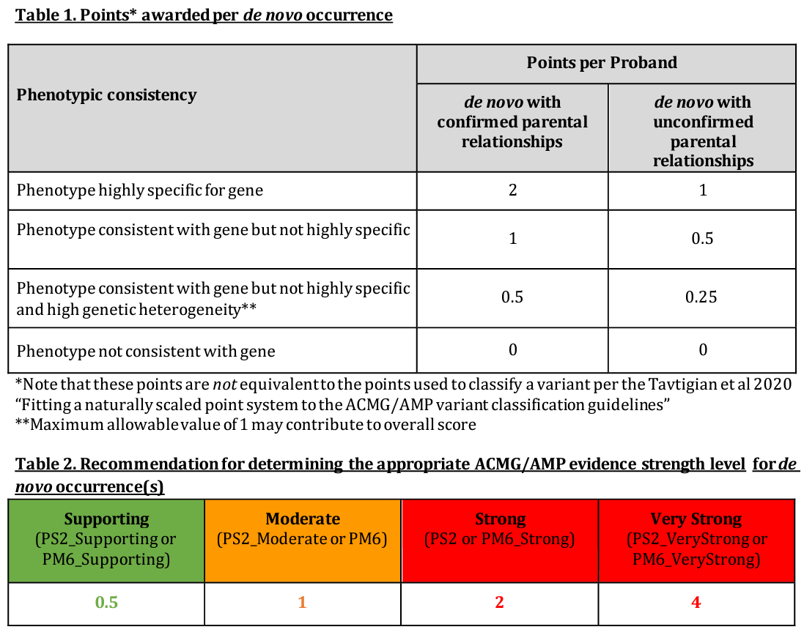
Update from ClinGen
Can adjust from PS2_Supporting to PS2
Phenotype in the patient must be consistent with the gene/disease
Phenotype highly specific for gene
increased levels of plasma branched-chain amino acids (BCKDHB)
Phenotype consistent with gene but not highly specific:
early infantile epileptic encephalopathy (SIK1)
Phenotype consistent with gene but not highly specific and high genetic heterogeneity
non-syndromic intellectual disability (ASH1L)

Slide 28

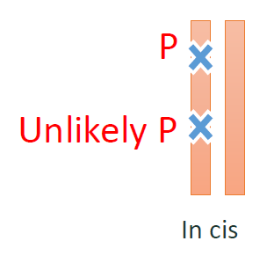
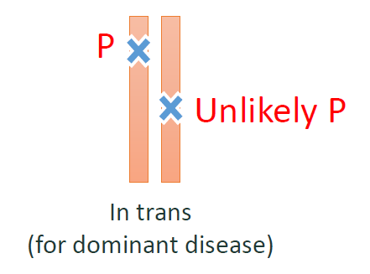
Allelic data (PM3, BP2)
PM3: For recessive disorders, detected in trans with a pathogenic variant
BP2: Observed in trans with a pathogenic variant for a fully penetrant dominant gene/disorder or observed in cis with a pathogenic variant in any inheritance pattern

Slide 29
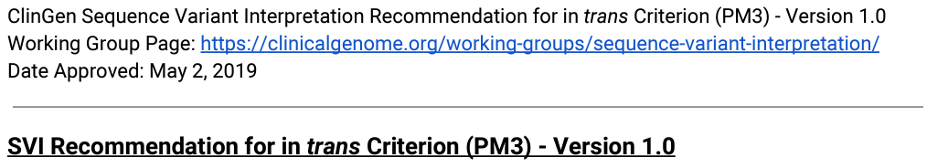
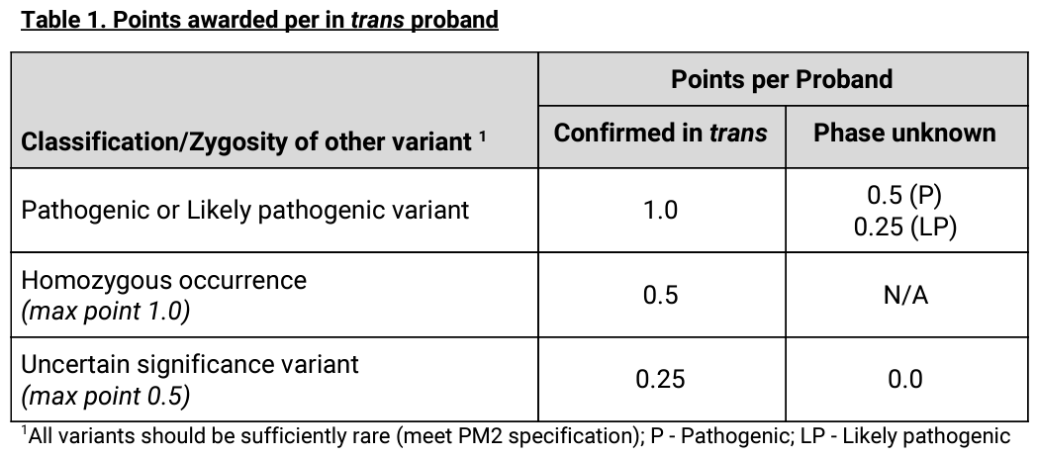
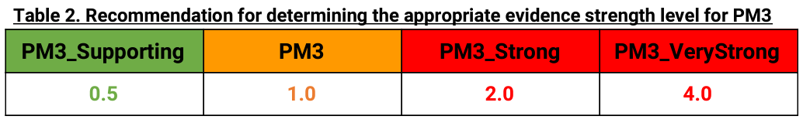
Update from ClinGen
Can adjust from PM3_VeryStrong to PM3_Supporting
Variant must meet PM2
Phasing may be confirmed by sequencing one patient
Avoid double counting of evidence
Applying PM3 to both v1 and v2 (v1+v2 observed in patient)
Applying PM3 to v1 only (v1+v2 observed in patient)
Applying PM3 to v1 and v2 (v1+v2 and v2+v3 observed in different patients)

